Slide 1
Capstone Project-2
Seoul Bike Sharing Demand Prediction
Jayesh

Slide 2

Flow of Presentation
Agenda
Data Summary
EDA
Data Preprocessing
ML models
Conclusion

Slide 3
Agenda
Currently Rental bikes are introduced in many urban cities for the enhancement of
mobility comfort.
It is important to make the rental bike available and accessible to the public at the right time as it lessens the waiting time.
Eventually, providing the city with a stable supply of rental bikes becomes a major concern.
The crucial part is the prediction of bike count required at each hour for the stable supply of rental bikes.
The objective of this project is to build a ML model which is optimal and which is able to predict the bike count required based on available features.

Slide 4
Data Summary
Date : The date of the day, type:str
Rented Bike Count - Number of rented bikes per hour and it is also a dependent variable, type:int
Hour - Hour of the day ranging from 0-23, type: int
Temperature (°C)- Temperature in Celsius, type:float
Humidity(%) - Humidity in the air in %, type: int
Wind speed (m/s) - Speed of the wind in m/s, type: float
Visibility (10m) - Visibility in m, type: int
Dew point temperature(°C) - The temperature at which the water starts to condense out of the air, type: float
Solar Radiation (MJ/m2) - Electromagnetic radiation emitted by the Sun, type: float
Rainfall(mm) - Amount of rainfall in mm, type: float italicized text
Snowfall(cm) - Amount of snowfall in cm, type: float
Seasons - Season of the year, type: str
Holiday - If the day is holiday or not, type: str
Functioning Day - Whether the day is functional or not, type:str

Slide 5
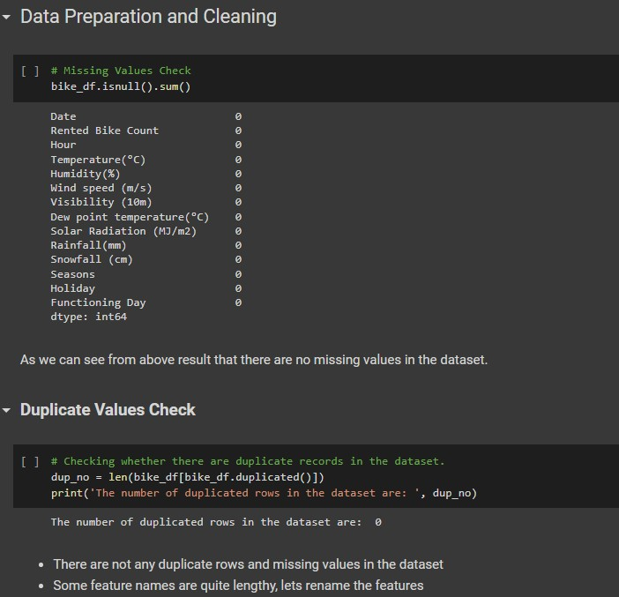
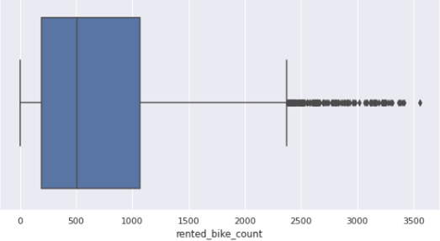
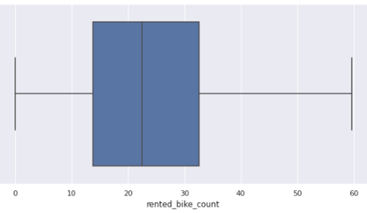
Cleaning of dataset dataset

Slide 6
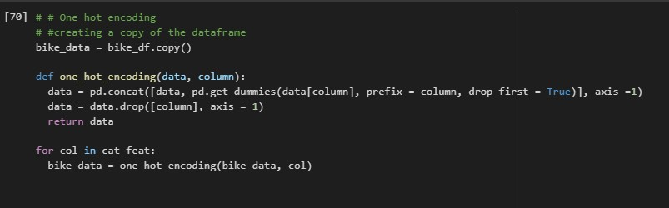
Data Preprocessing
Creating dummy variables for categorical variables using one hot encoding.
A one hot encoding allows the representation of categorical data to be more expressive.
Many machine learning algorithms cannot work with categorical data directly.
The categories must be converted into numbers.
This is required for both input and output variables that are categorical

Slide 7
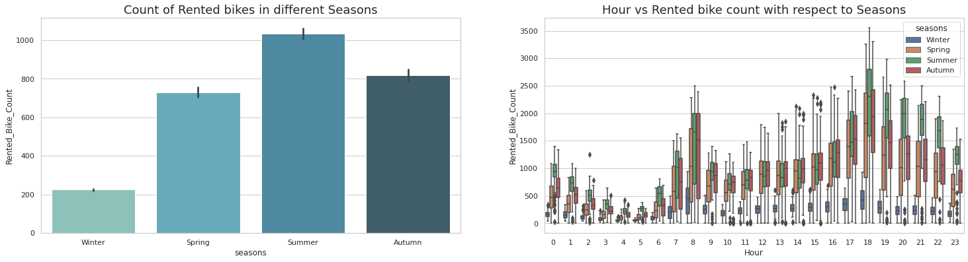
Data Visualization
From above graph it is observed that, people prefer renting bikes highest at summer and least at winter.

Slide 8
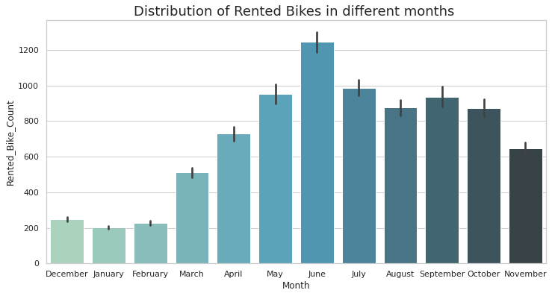
Rented Bike distribution in different months
From above graph it is observed that, highest number of rented bikes count is in month June.
Sudden increase after March and counts starts to decrease after June

Slide 9
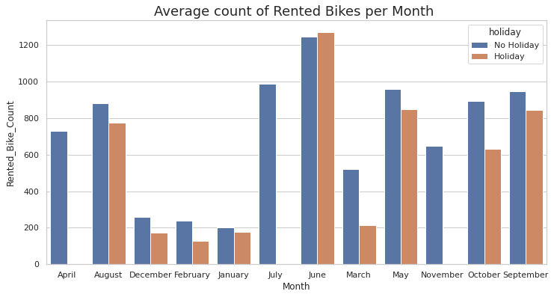
Rented Bike distribution in different months w.r.t Holiday/Non Holiday
On Non-Holidays average count of rented bike is higher in June and same for Holidays. The reason can be related with temperatures, also June comes in summer season and we already observed that summer season have high number of rented bikes , possible reason can be most number of tourists visits in the month of June

Slide 10
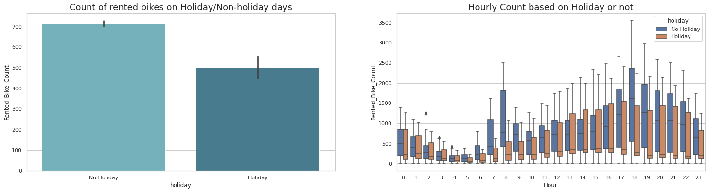
Relation between Rented bikes and Functioning/Non-Func Hours
There is no rented bike counts in Non-Functioning hours
Number of rented bikes is on Non holidays are higher compared to Holidays. Also, having high number of rented bikes in all 24 hours is higher in Non holidays compared to Holidays.

Slide 11
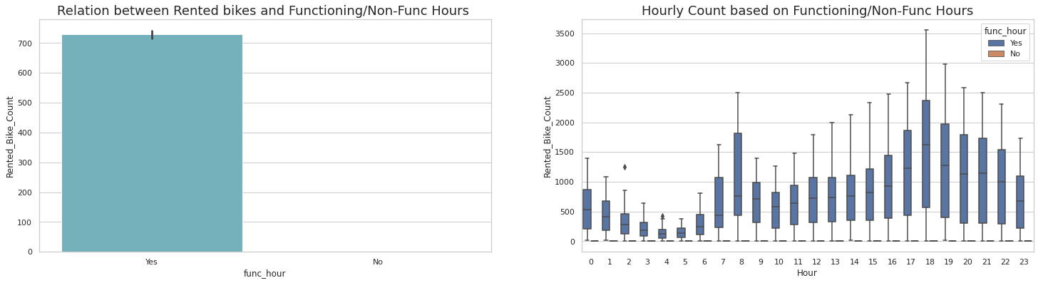
Relation between Rented bikes and Functioning/Non-Func Hours

Slide 12
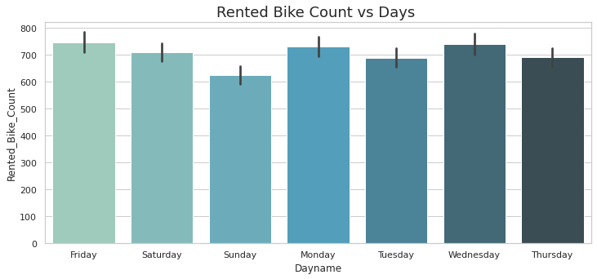
Rented bike vs weekday
Sunday have lowest number of rented bikes compared to other weekdays and we already have seen that there is low number of rented bikes on Holidays

Slide 13
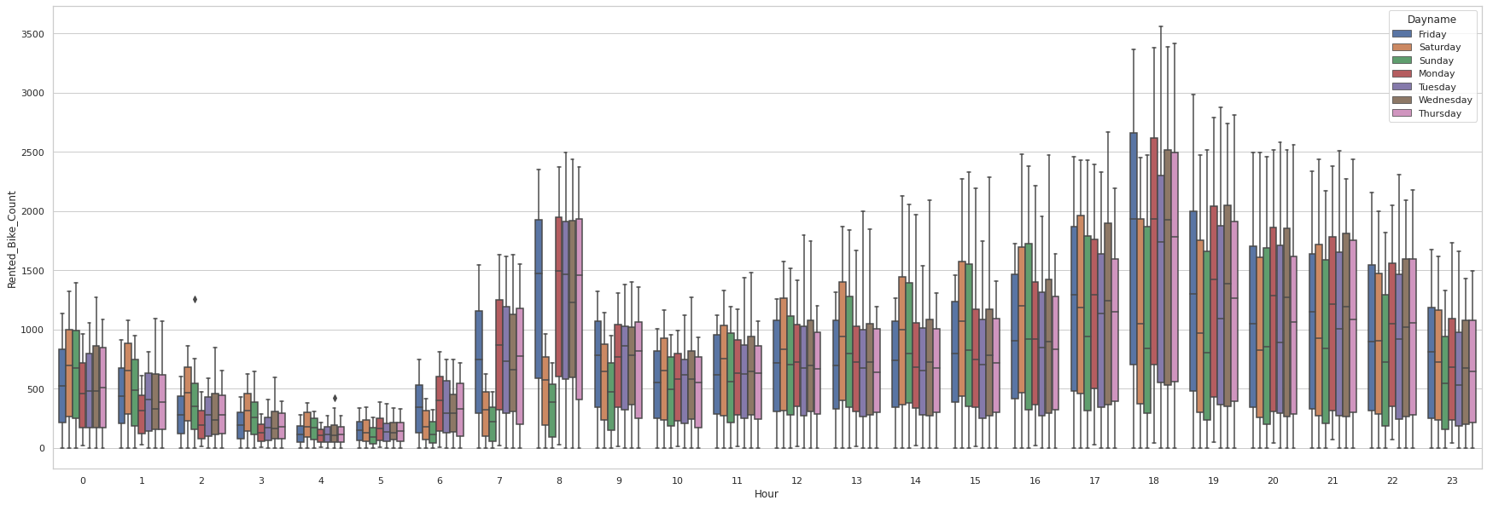
Distribution along with Days and Hours
As we have observed 7 to 8AM are the most rented bike hours and 5 to 7 PM also, but we can see that even in these busiest hours sunday have very less number of rented bikes

Slide 14
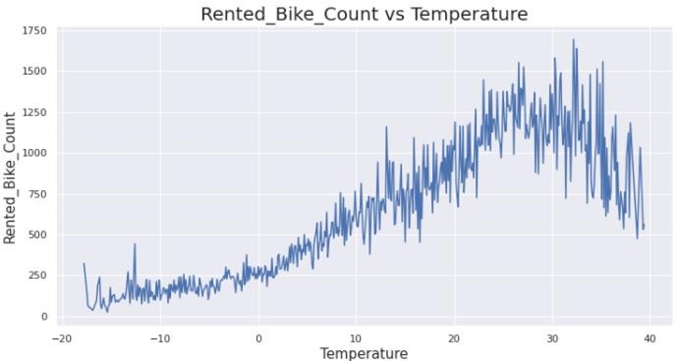
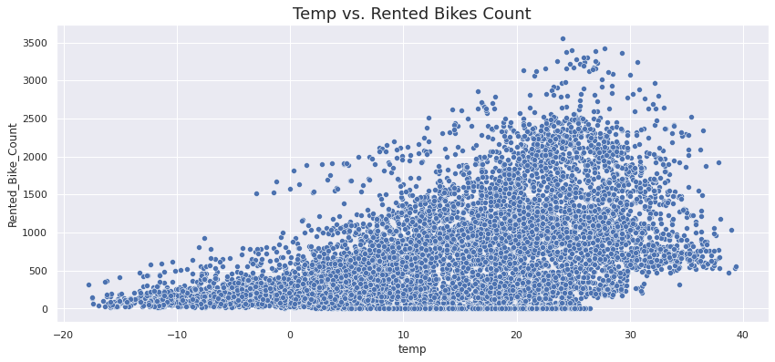
Temperature
The bike count increases with temperature. The demand is maximum around 25-35 °C.
Very less number of rented bikes below 0°C

Slide 15
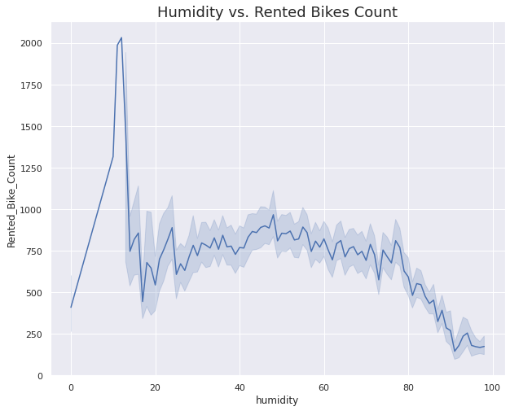
Humidity
Highest count of rented bikes is at around 17% Humidity
As Humidity increases the number of rented bikes decreases

Slide 16
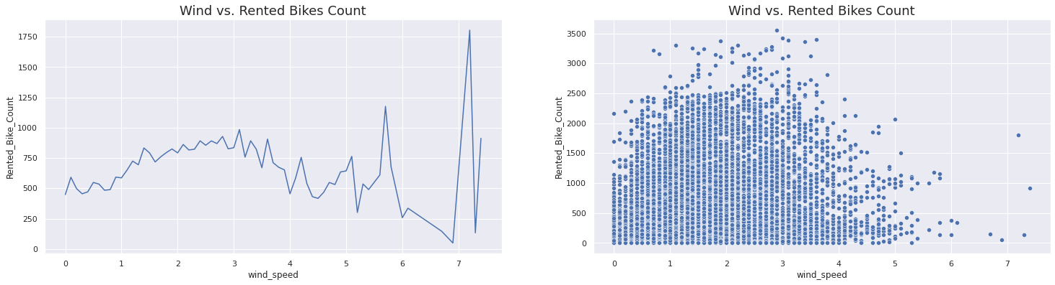
Data Visualization
Rented bikes increases till 3m/s but after that it starts to decreasing, but between 5 and 6m/s there's sudden increase and same after 7m/s

Slide 17
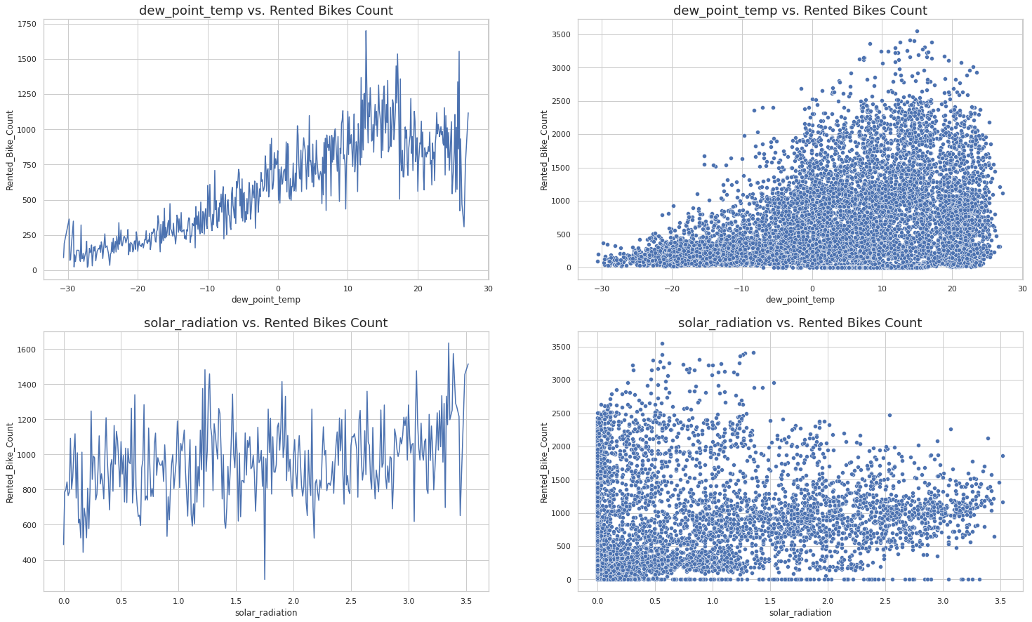
Effect of Dew point temp and Solar radiation
Below 0 degree celcius means very cold weather and less number of rented bikes
Dew temperature is behaving same as Temperature (Can be correlated with Temperature variable)
As dew point temperature increase rented bike count also increases
At 13 degree celcius there is highest number of rented bike count

Slide 18
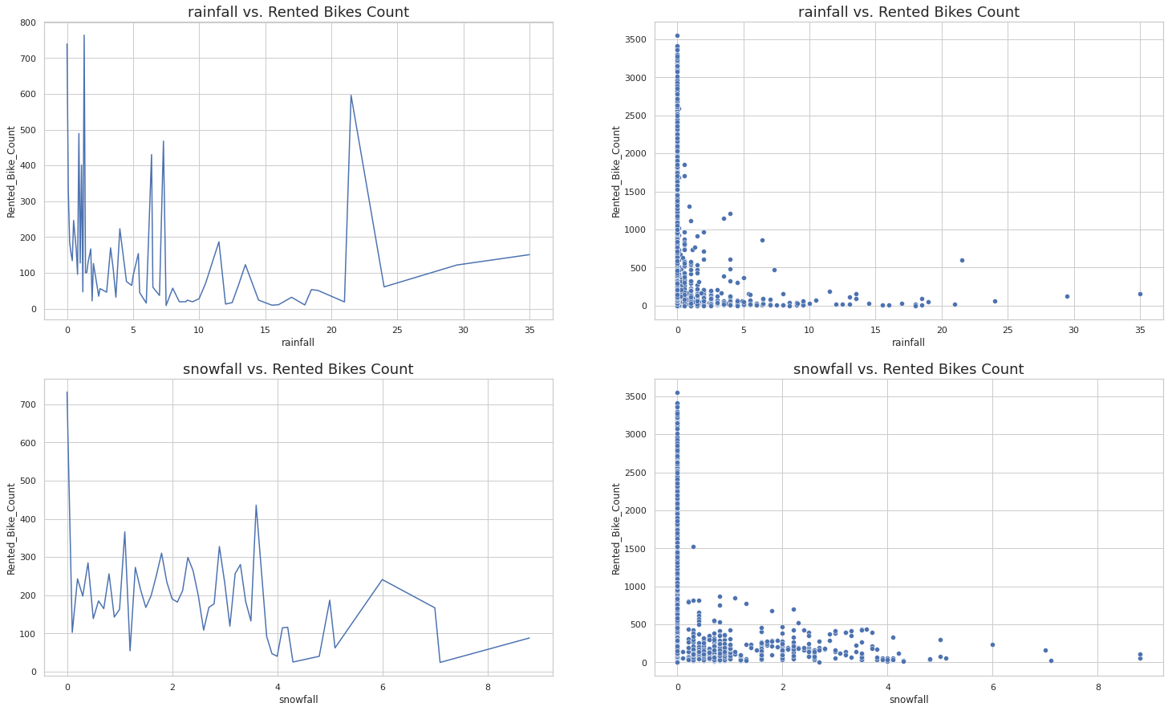
Effect of Rainfall and Snowfall
Both Rainfall and Snowfall have almost similar relation with Rented bike counts
Around 0mm rainfall and 0cm snowfall there is high number of Rented bikes means normal weather have high number of rented bikes and it is also obivious that in Rainfall or Snowfall people like to stay indoors

Slide 19
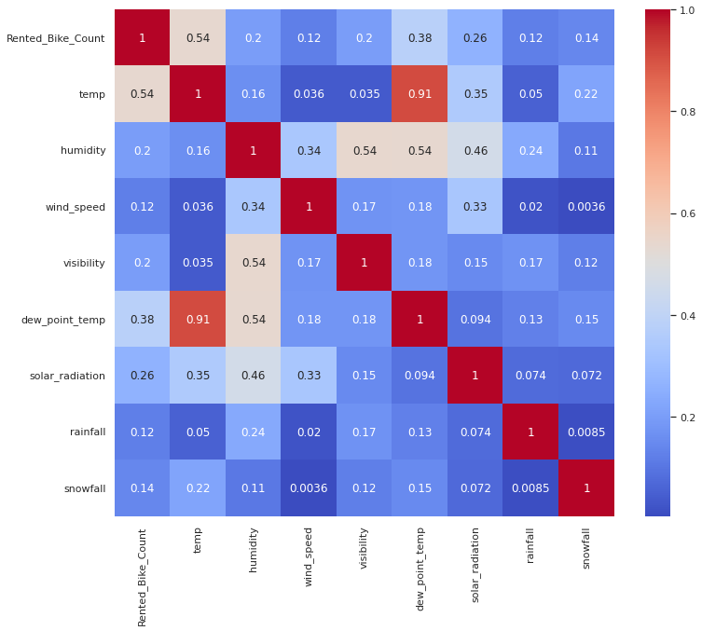
Correlation
The correlation between temperature and dew point temperature is 0.91 which is quite high. To eliminate multicollinearity we will merge those 2 features to form a single feature.

Slide 20
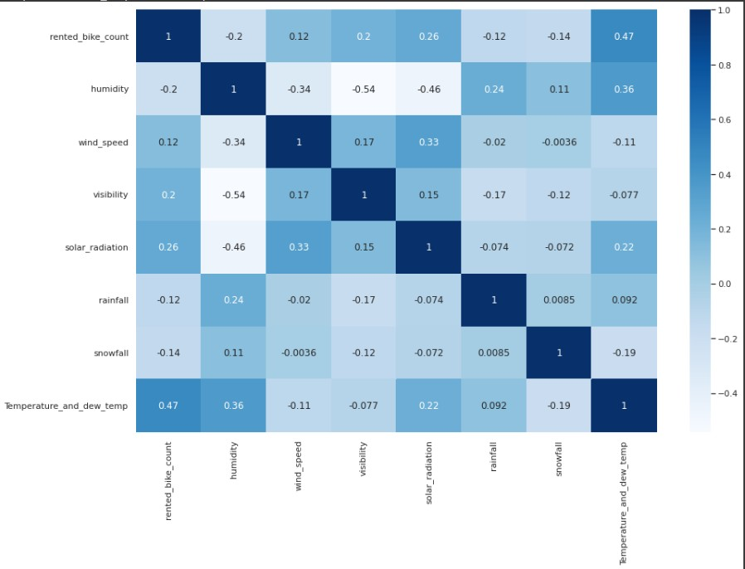
Feature Engineering
Combining the high correlated features to form single feature called temperature and dew point feature.

Slide 21
Model Building
Linear Regression
Lasso Regression
Ridge Regression
Decision Trees Regressor
Random Forest Regressor
Gradient Boosted Regressor
Gradient Boosting Regressor With Gridsearch cv

Slide 22
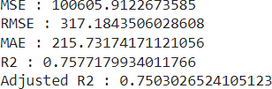
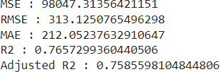
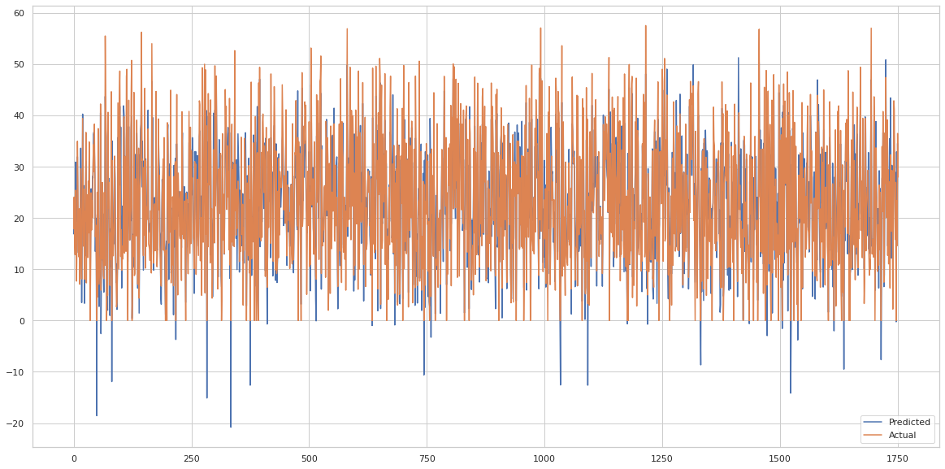
Evaluation Metrics - Linear Regression Model
Training Data Testing Data

Slide 23
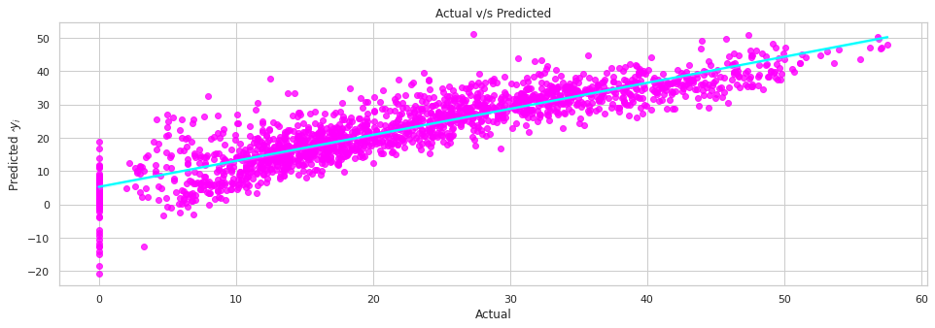
Evaluation Metrics - Linear Regression Model
Training Data Testing Data

Slide 24
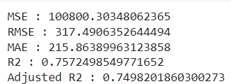
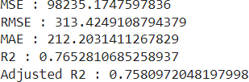
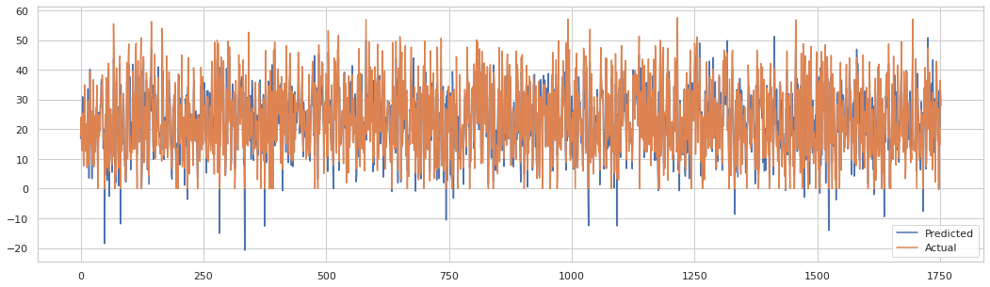
Evaluation Metrics - Lasso Regression
Training Data
Testing Data

Slide 25

Evaluation Metrics - Lasso Regression
Training Data
Testing Data

Slide 26
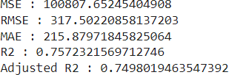
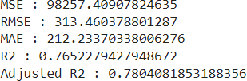
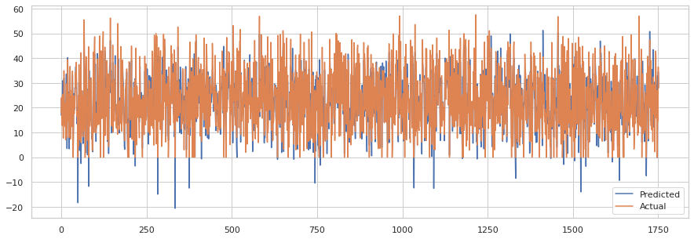
Evaluation Metrics - Ridge Regression
Training Data
Testing Data

Slide 27
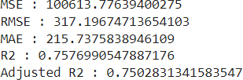
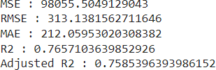
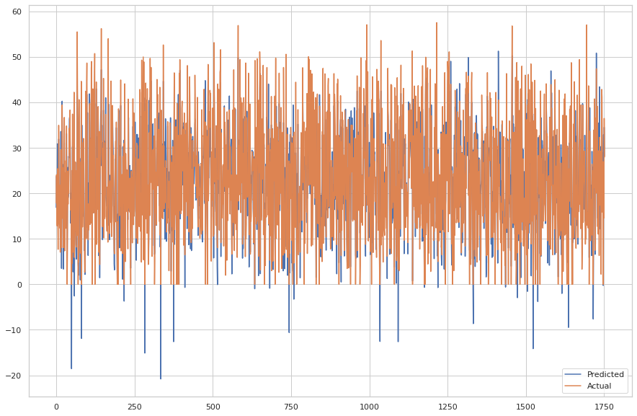
Evaluation Metrics - Elastic Net Regression
Training Data
Testing Data

Slide 28
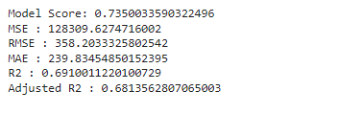

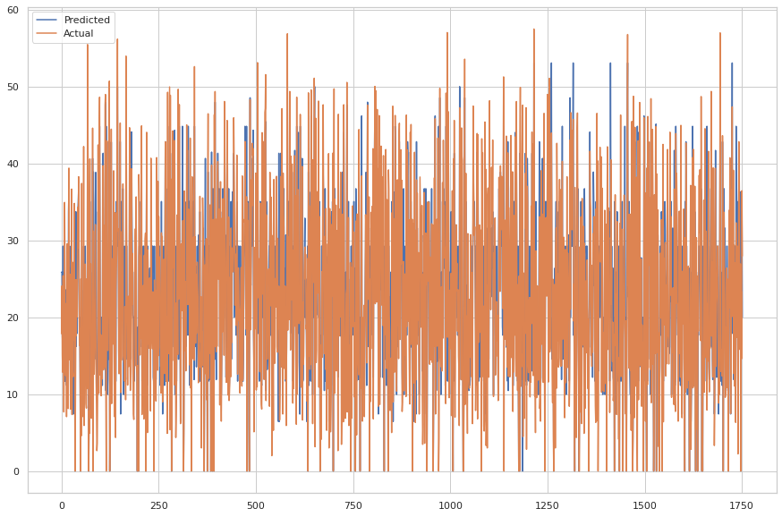
Decision Tree
Training Data
Testing Data

Slide 29
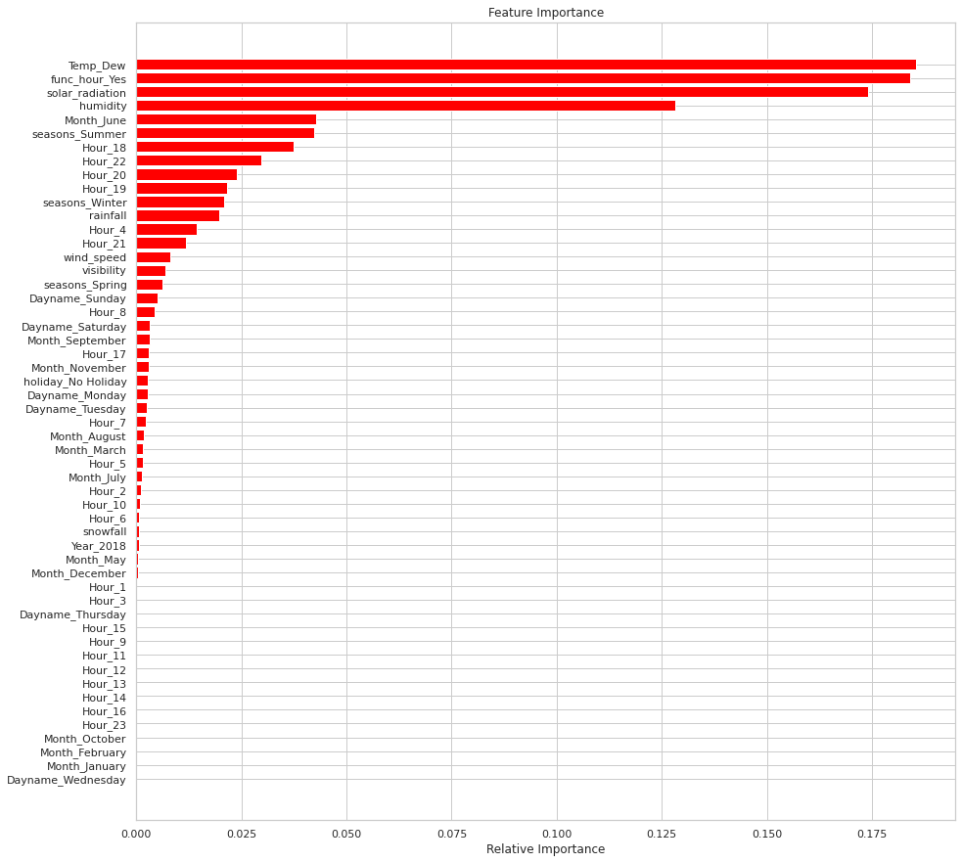
Feature Importance - Decision Tree

Slide 30
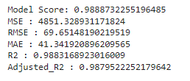

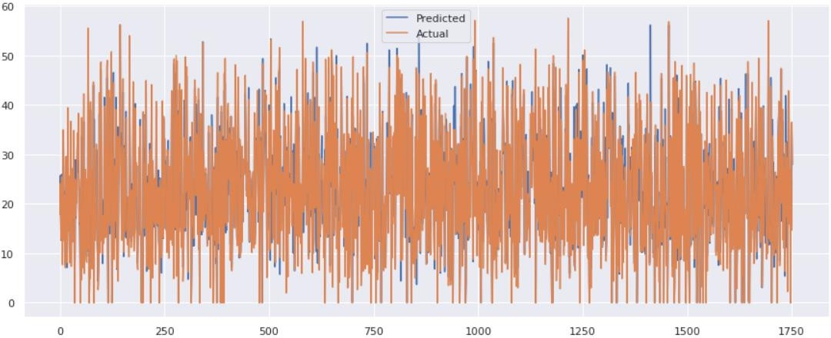
Evaluation Metrics - Random Forest
Training Data
Testing Data

Slide 31
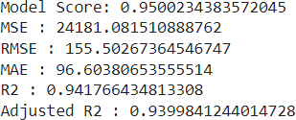
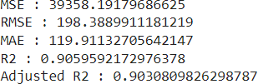
Evaluation Metrics - Gradient Boost
Training Data
Testing Data

Slide 32



Hyperparameter tuning of Gradient Boost via GridsearchCV
Best Parameters
Training Data
Testing Data

Slide 33
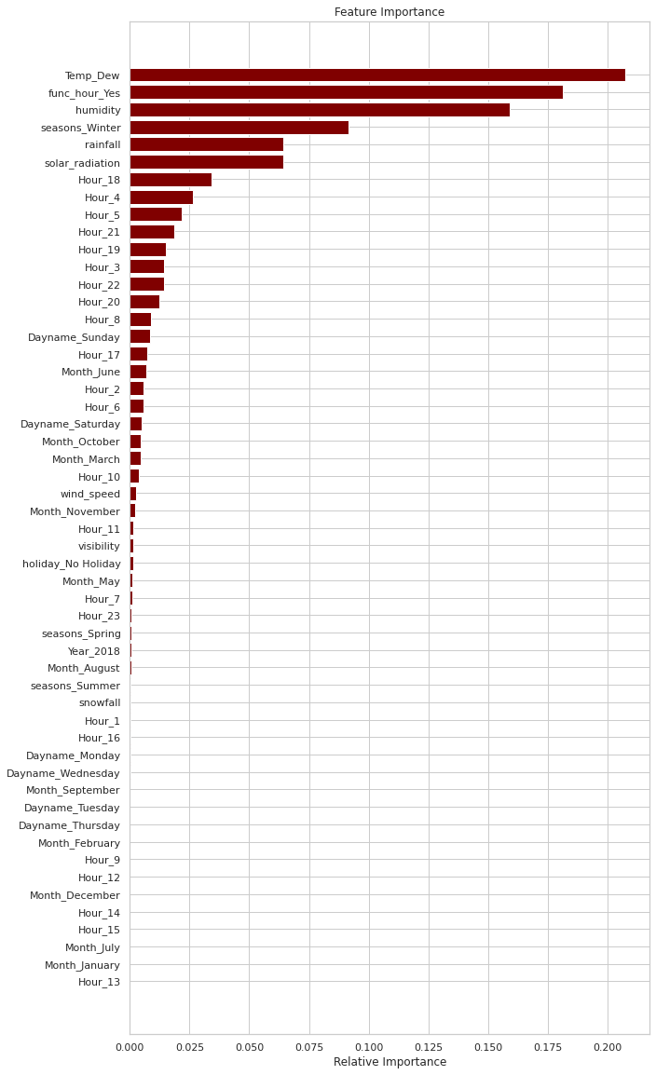
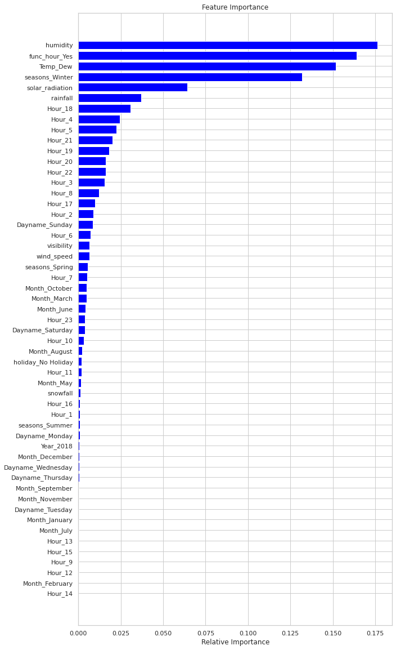
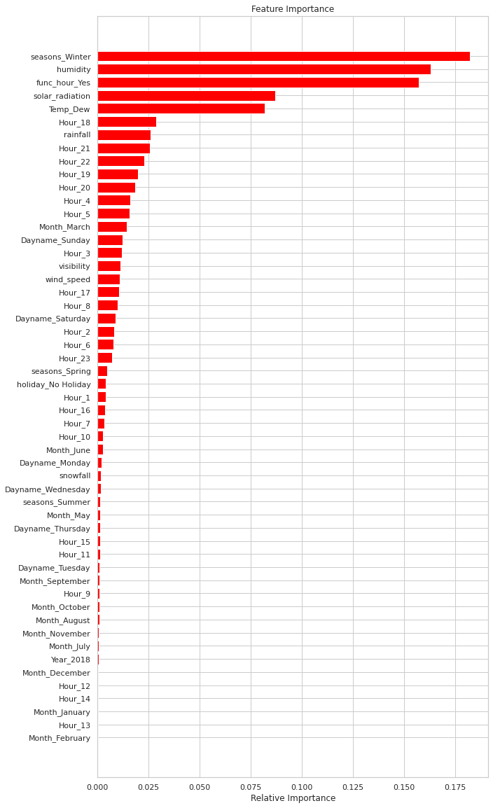
Feature Importance(RF vs Gradient Boosting vs Gridsearch CV GB)

Slide 34
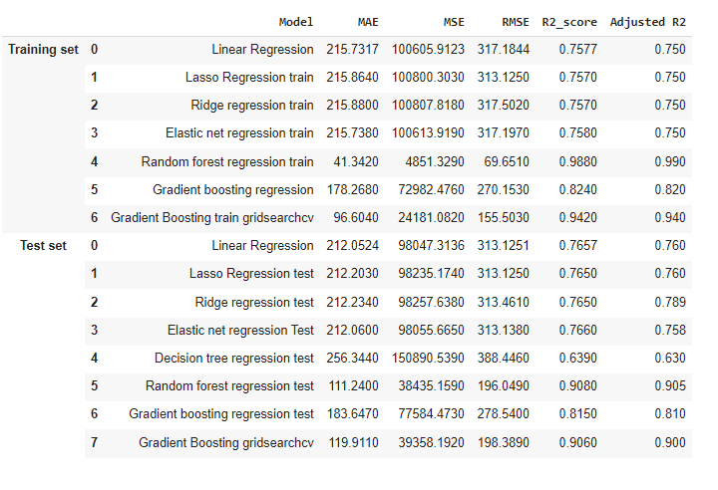
Final Results

Slide 35
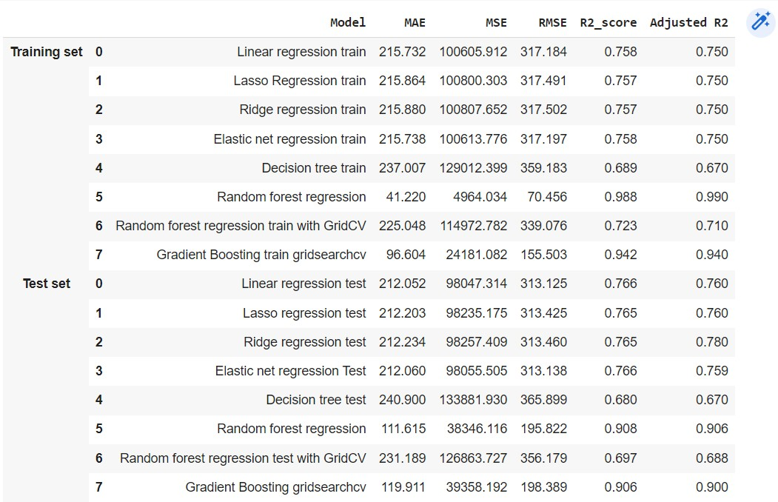
Summary

Slide 36
Conclusion
Most Number of bikes rented are in Summer Season, it can be due to more Tourists usually visit Seoul during summer season
Most number of bikes are rented in the month of June followed by June and it can be due to Seoul's Ulsan Whale cultural festival. The best time of year to visit Seoul is generally considered to be the spring months of April, May & June, and the autumn months of September, October & November. During these two seasons days are typically sunny and dry with comfortable average temperatures.
On Non-Holidays average count of rented bike is higher in June and same for Holiday
High number of rented bikes at 8AM because people left their home to reach at destination by 9AM and same for higher number at 6 PM.
Number of rented bikes on Non holidays are higher compared to Holidays. Also, having high number of rented bikes in all 24 hours is higher in Non holidays compared to Holidays.
As the temperature increases number of rented bikes also increases Highest count of rented bikes is at around 17% Humidity
As Humidity increases the number of rented bikes decreases
As dew point temperature increase rented bike count also increases and At 13 degree celcius there is highest number of rented bike count
'Temperature', 'Wind_speed', 'Visibility', 'Dew_point_temperature', 'Solar_Radiation' are positively Corelated with Dependant variable which means the rented bike count increases with increase of these variables.
Linear,Lasso,Ridge and Elastic regression models have almost similar R2 scores 75% and 76% on both training and test data respectively
We got R2 square for Decision tree in training data 69% and for test data we got 63% which is quite low compared to other algorithms
We got highest R2 score in Random forest regression with 90%
The R2 score increased in Gradient boosting after tuning with hyperparameters, without tuning it was 81% and after tuning it was 90%
We can use Gradient Boosting Regression(GridSearchCV) and Random forest for deployment

Slide 37

THANK YOU

